Slide 1
Assessing HDAC2 Knockout Effects on CD4+ T Cell Signalling in Mouse Skin
Karla Mangano

Slide 2
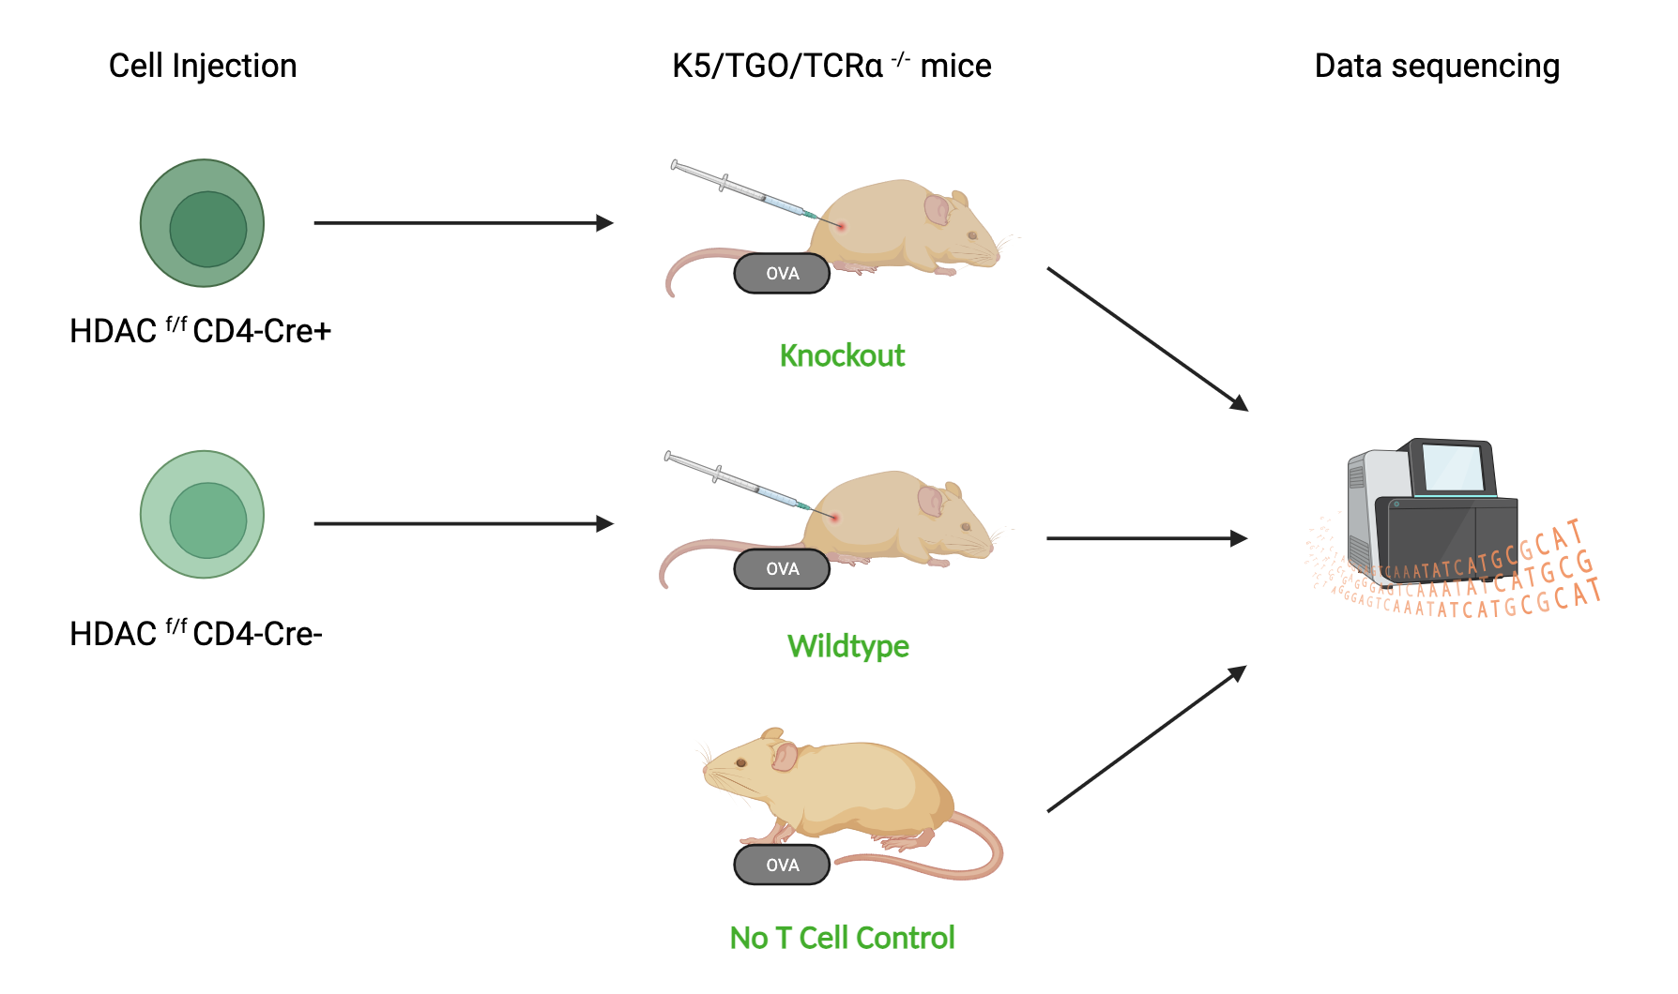
The Experiment
Source: Created with Biorender
Notes:
K5/TGO/TCR alpha -/- Mouse: Alterations in the Hedgehog signaling pathway -> lacks TCR alpha chains -> affects T cell development + function, also causes production of Ovalbumin in the skin in the presence of doxycycline. The injected t-cells have a reaction to the ovalbumin similar to an autoimmune reaction. Express ovalbumin due to presence of K5 + TGO transgenes. Ovalbumin is recognised as a foreign substance by the immune system.
HDAC1 f/f CD4-Cre+ Mouse: HDAC knockout
Cre Recombinase causes HDAC gene to be cut out specifically in T-cells at CD4 promotor.

Slide 3
Hypothesis:
No T cell mice → no cell signalling consistent with an immune reaction.
Wildtype → strong immune reaction of CD4+ cells to OVA.
Knockout → immune reaction to OVA reduced by HDAC2 deletion in CD4+ cells.
Aim:
Investigate CD4+ T cell signalling during immune reaction to OVA in mutant mouse skin and evaluate the impact of HDAC2 knockout in altering these signalling pathways.

Slide 4
Data:
→ Mouse Skin
→ HDAC2 Knockout
→ Gene expression values
→ Communication probability calculated using
R package: Cell chat.
→ Diagrams created using R packages: ggplot + Cellchat.

Slide 5
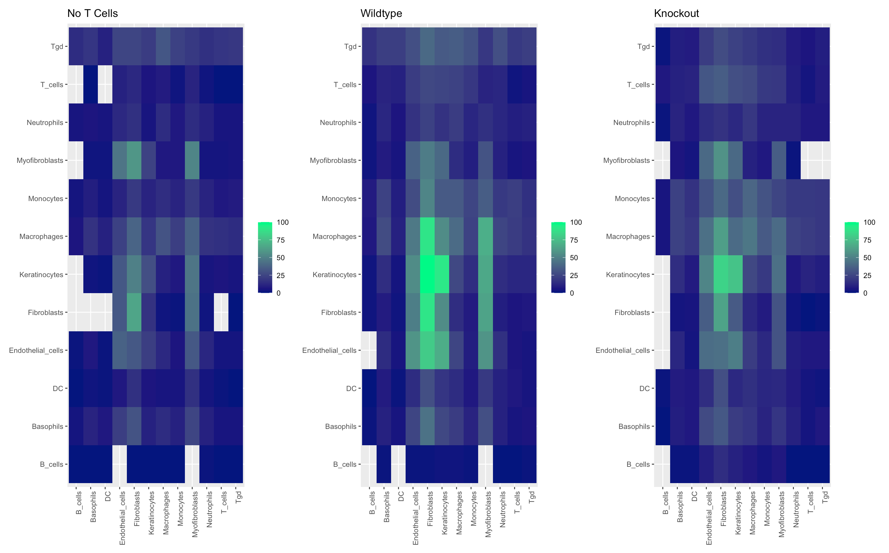
Changes in cell-cell communication
Increased cell-cell interactions in WT and KO mice
Notes:
The introduction of CD4+ T-cells triggers an immune response in the mice due to the recognition of ovalbumin as a foreign antigen. This immune response often involves the release of inflammatory mediators, such as cytokines and chemokines. These signals can stimulate myofibroblasts and fibroblasts, leading to increased communication and activation.

Slide 6
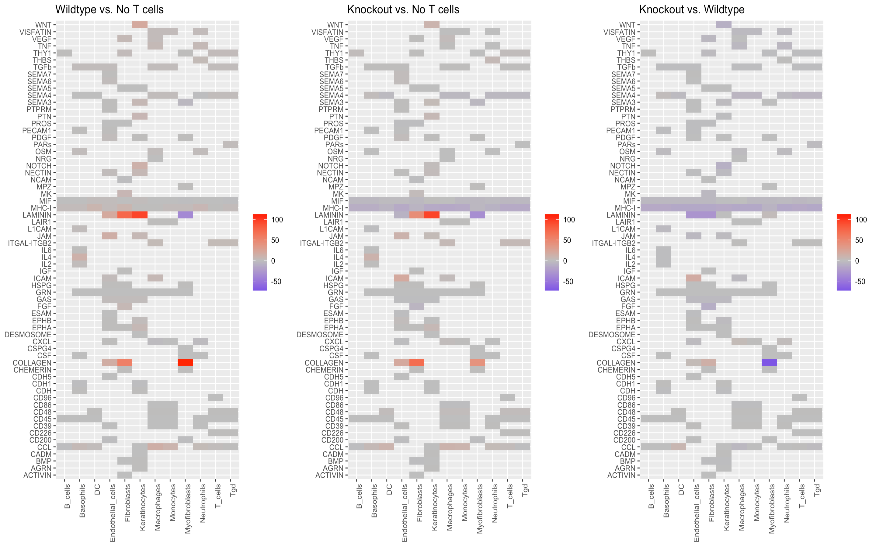
Differences in # of pathway Interactions from Source cells
Notes:
Wildtype + Knockout both have an increased number of pathway interactions when compared with No T cell mice.
Knockout has slightly less interactions than wildtype , especially a decrease in myofibroblasts as source for collagen pathway.
Wildtype has the strongest immune reaction.

Slide 7
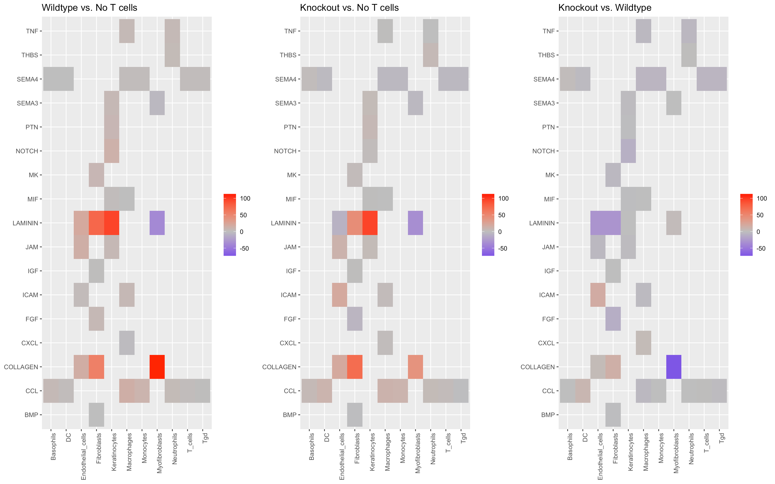
Differences in # of pathway Interactions from Source cells (Zoomed in)
Notes:
The Laminin and Collagen pathways in Wildtype and knockout mice have increased signalling.
No T cell mice have more signalling from myofibroblasts in laminin pathway.
Knockout has less signalling in myofibroblast mediated collagen pathway in comparison to Wildtype.
Interesting pathways include: Laminin and Collagen.

Slide 8
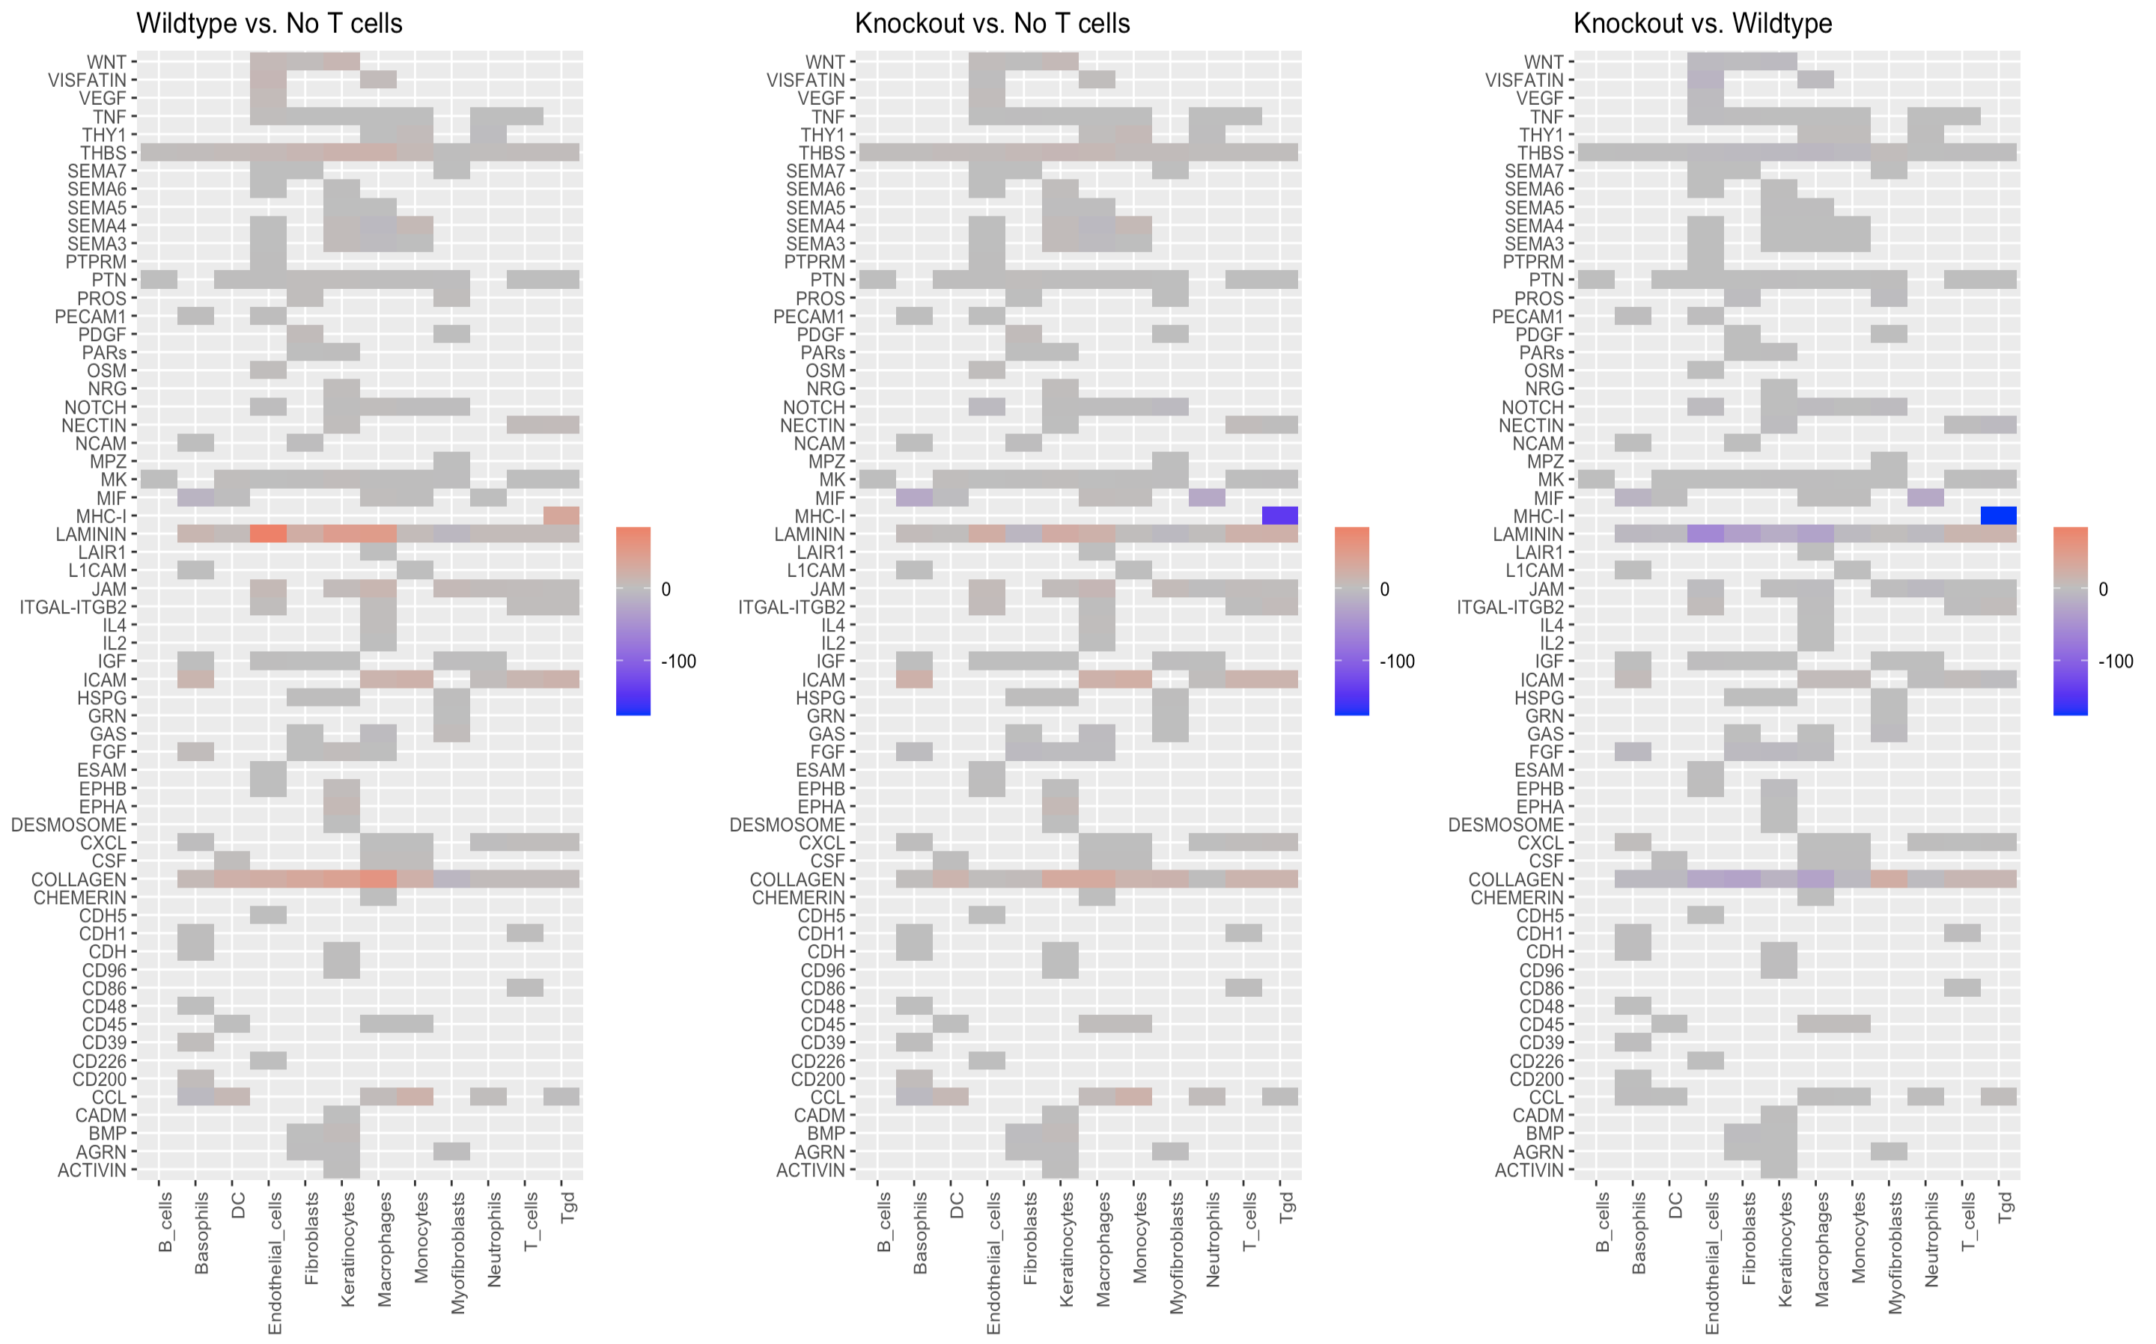
Differences in # of pathway Interactions from target cells
Notes:
Knockout has sig less MHC-I pathway interactions by Tgd than noT and wildtype. HDAC2 must be important for MHC-I tgd cell interactions.
Wildtype still has sig more interactions of the Laminin and Collagen pathways than no t cell, particulary in endothelial cells.

Slide 9
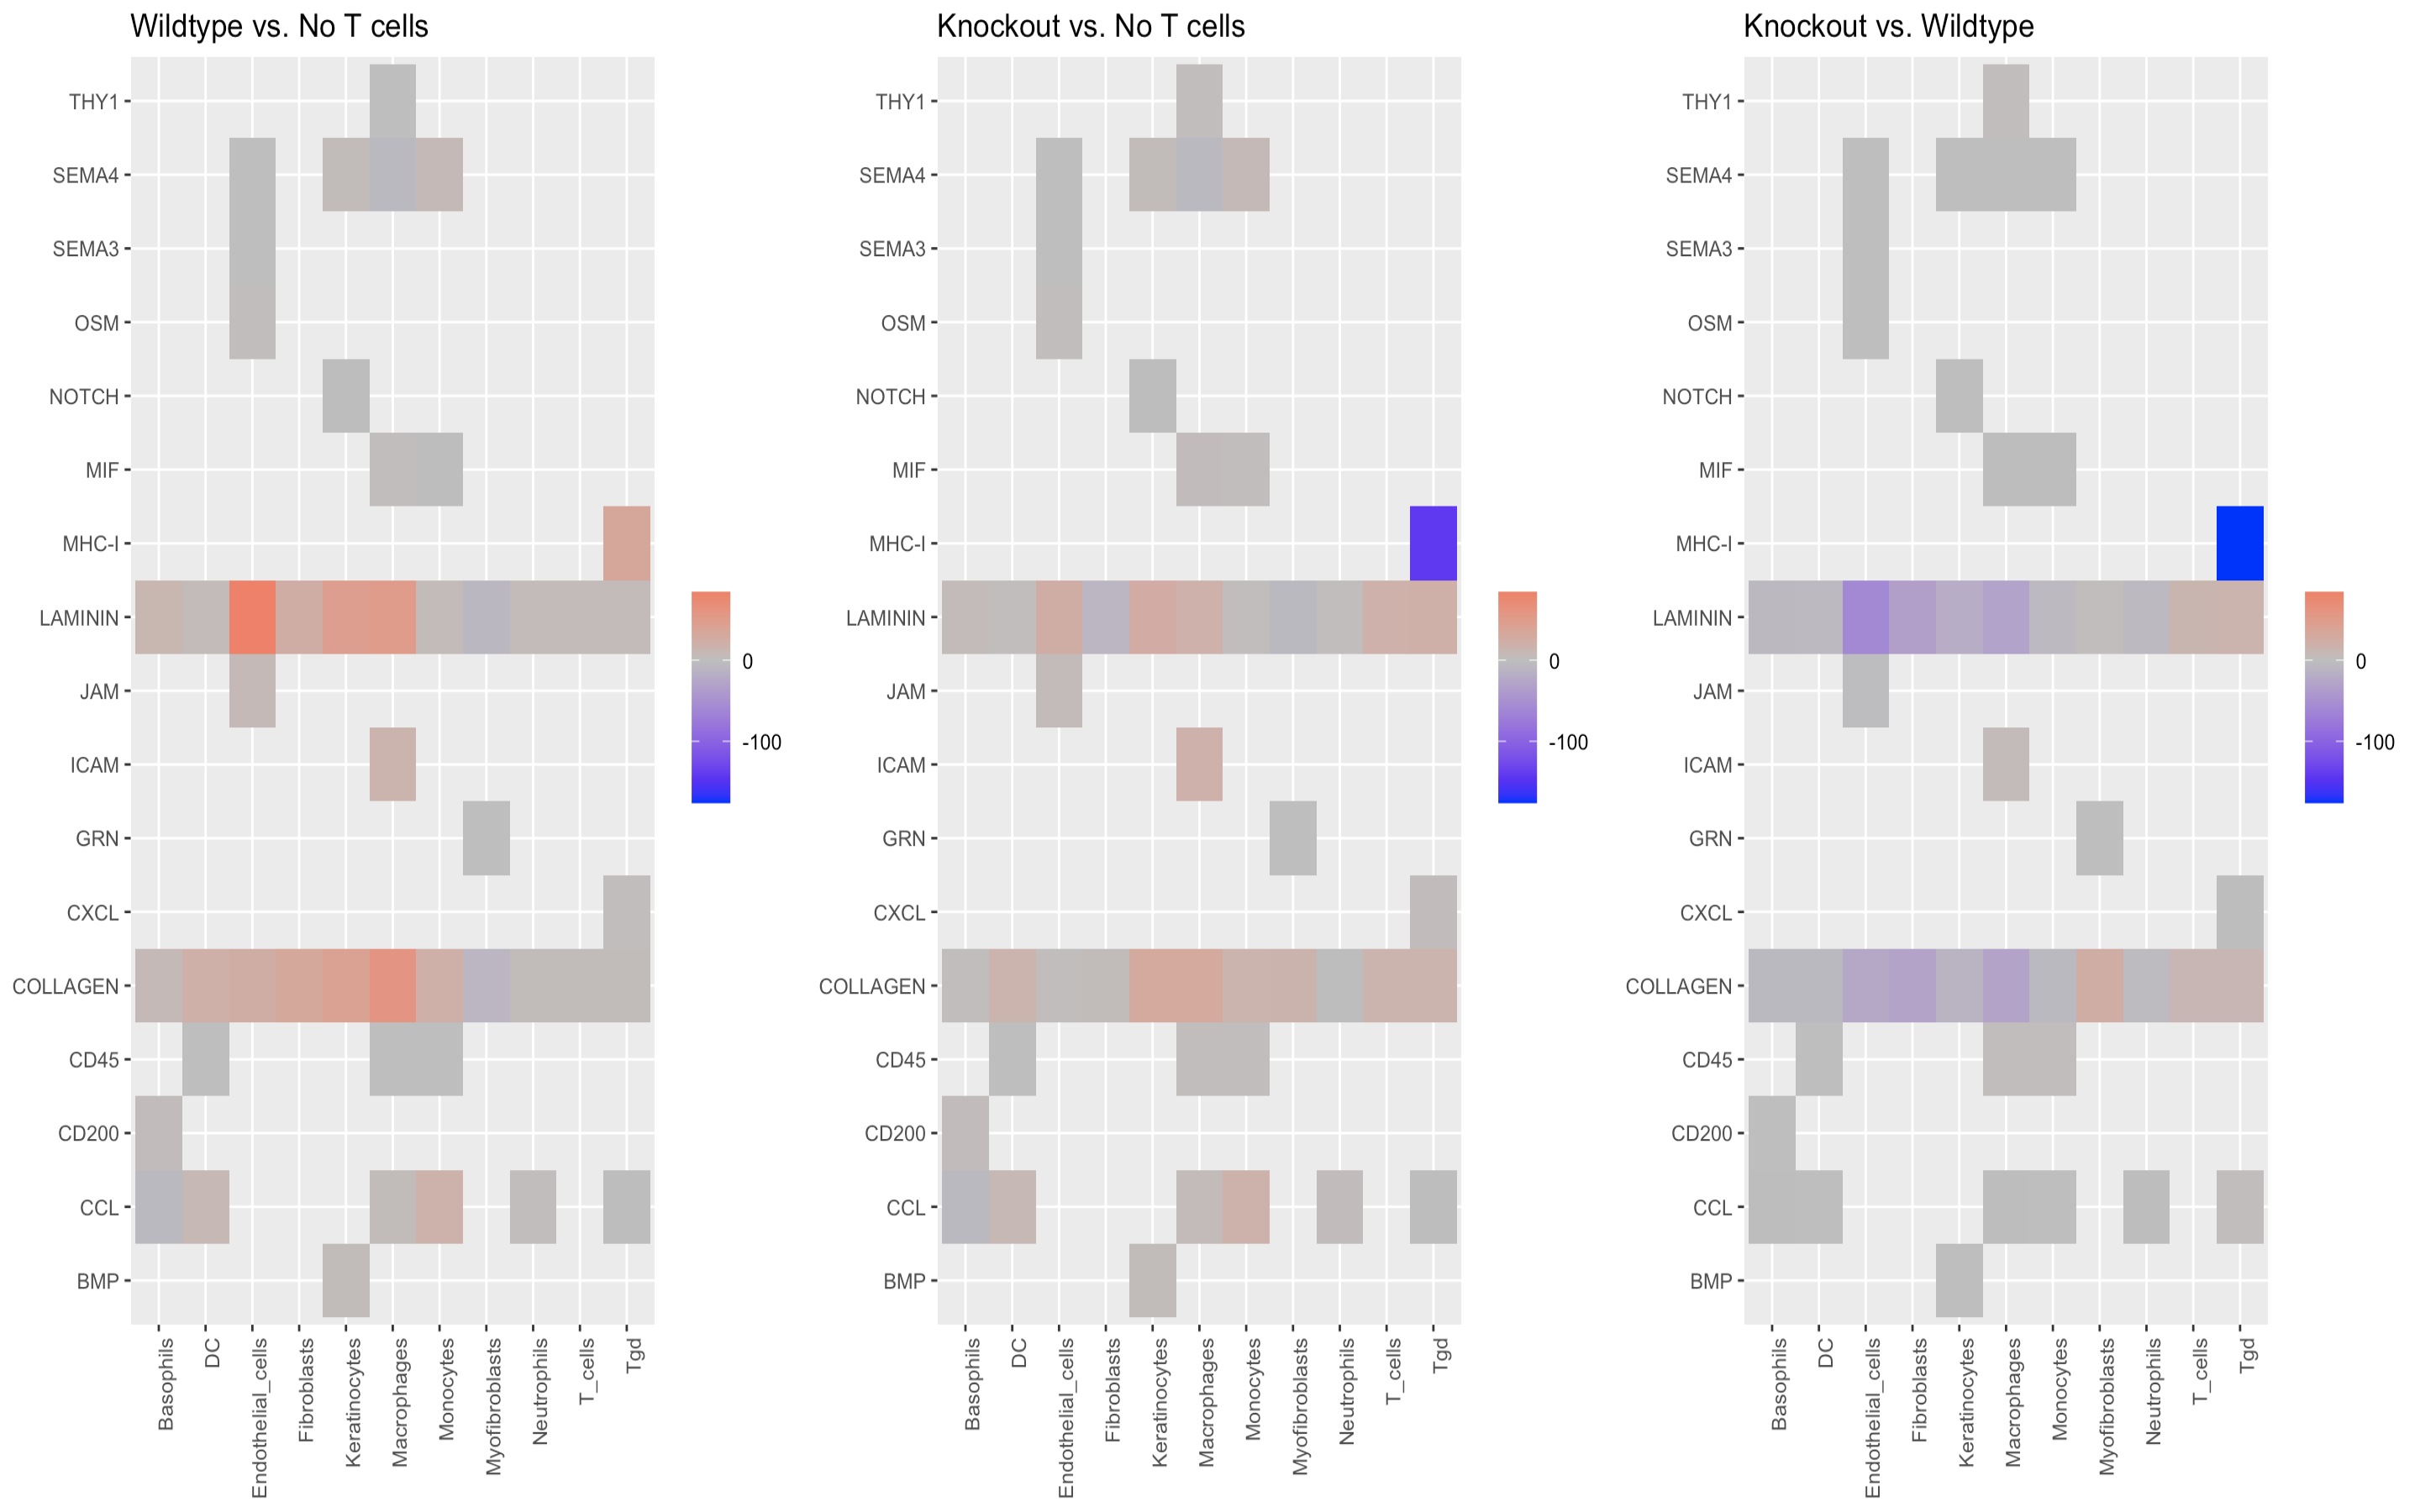
Differences in # of pathway Interactions from target cells (Zoomed in)
Notes:
Knockout has close to no MHC-I Tgd function (12 interactions compared to 188 wt and 154 noT). This is because HDAC2 is very important for MHC-1 function.

Slide 10
Findings
→ Wildtype mice show ↑ in Laminin + Collagen pathways by Keratinocytes, Fibroblasts, Myofibroblasts + Endothelial cells.
→ HDAC2 knockout mice show reduced MHC-I signalling to Tgd cells.
→ How are these pathways changed? Investigate cell signalling in individual pathways, main contributing ligand-receptor bindings + gene expression.

Slide 11
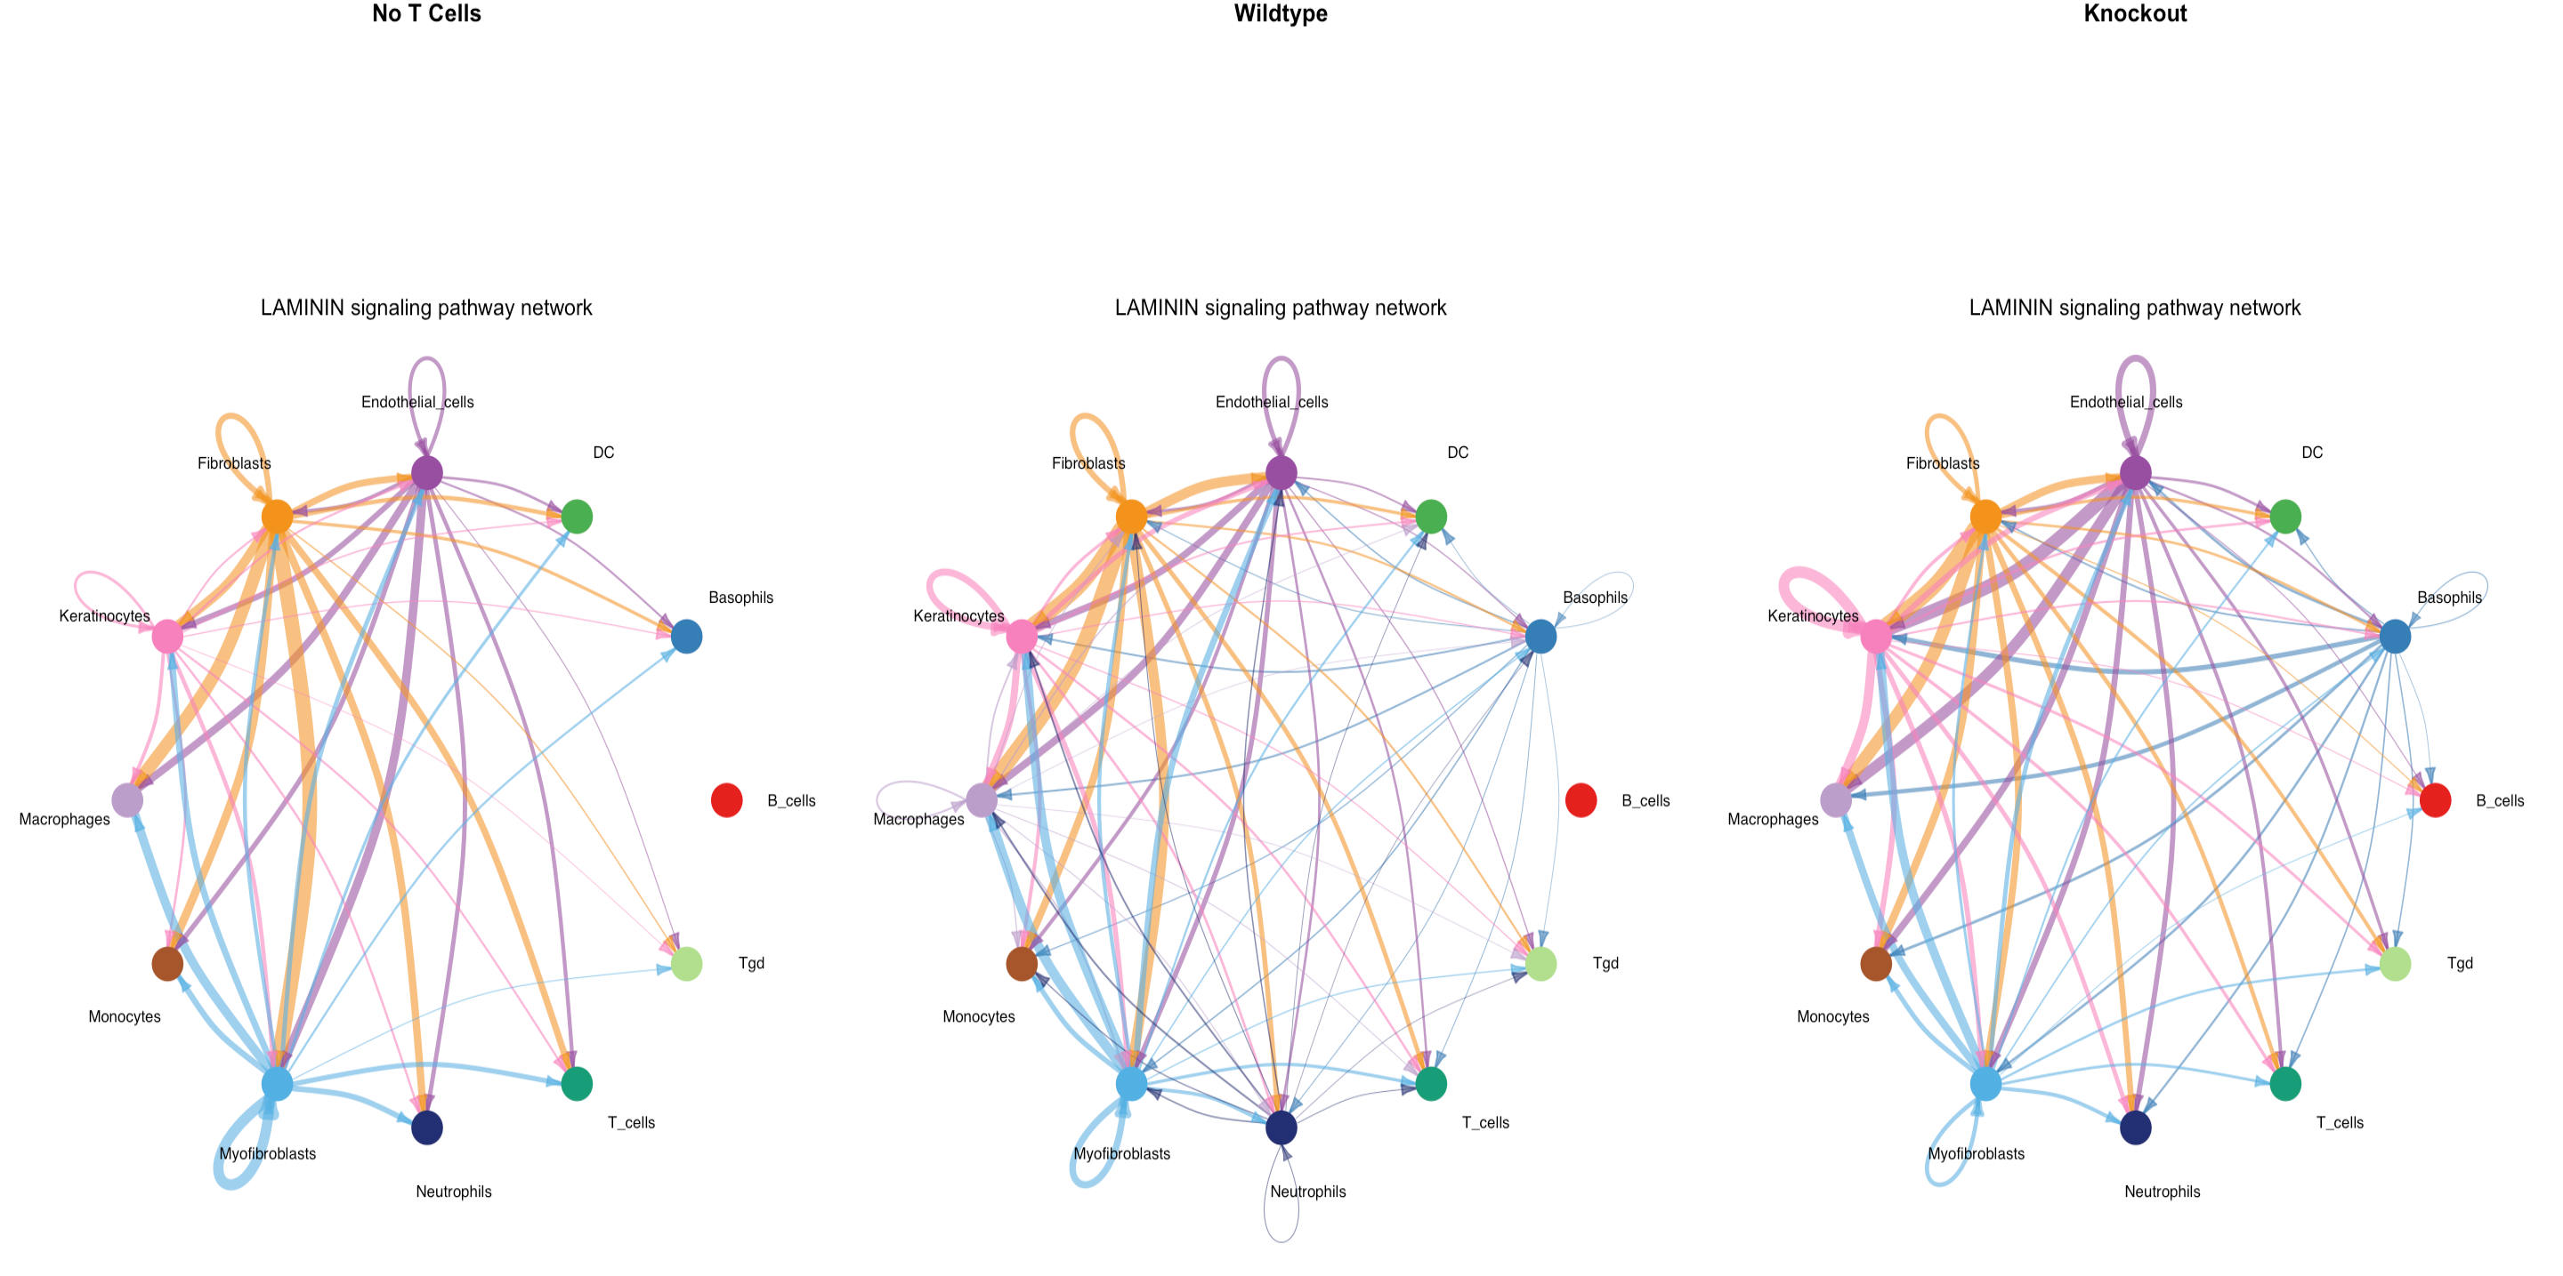
Laminin Pathway - Cell-Cell interactions
↑ Sig. from Keratinocytes
↑ Sig. to Endothelial Cells
↑ Sig. to T Cells
↑ Sig. to Neutrophils
↑ Sig. from Keratinocytes
↑ Sig. to Endothelial Cells
↑ Sig. to B cells
Notes:
Wildtype has increased signalling in inflammatory cells: Neutrophils, Macrophages
No B_cell signalling in Laminin pathway of NoT + Wildtype mice = may be due to

Slide 12
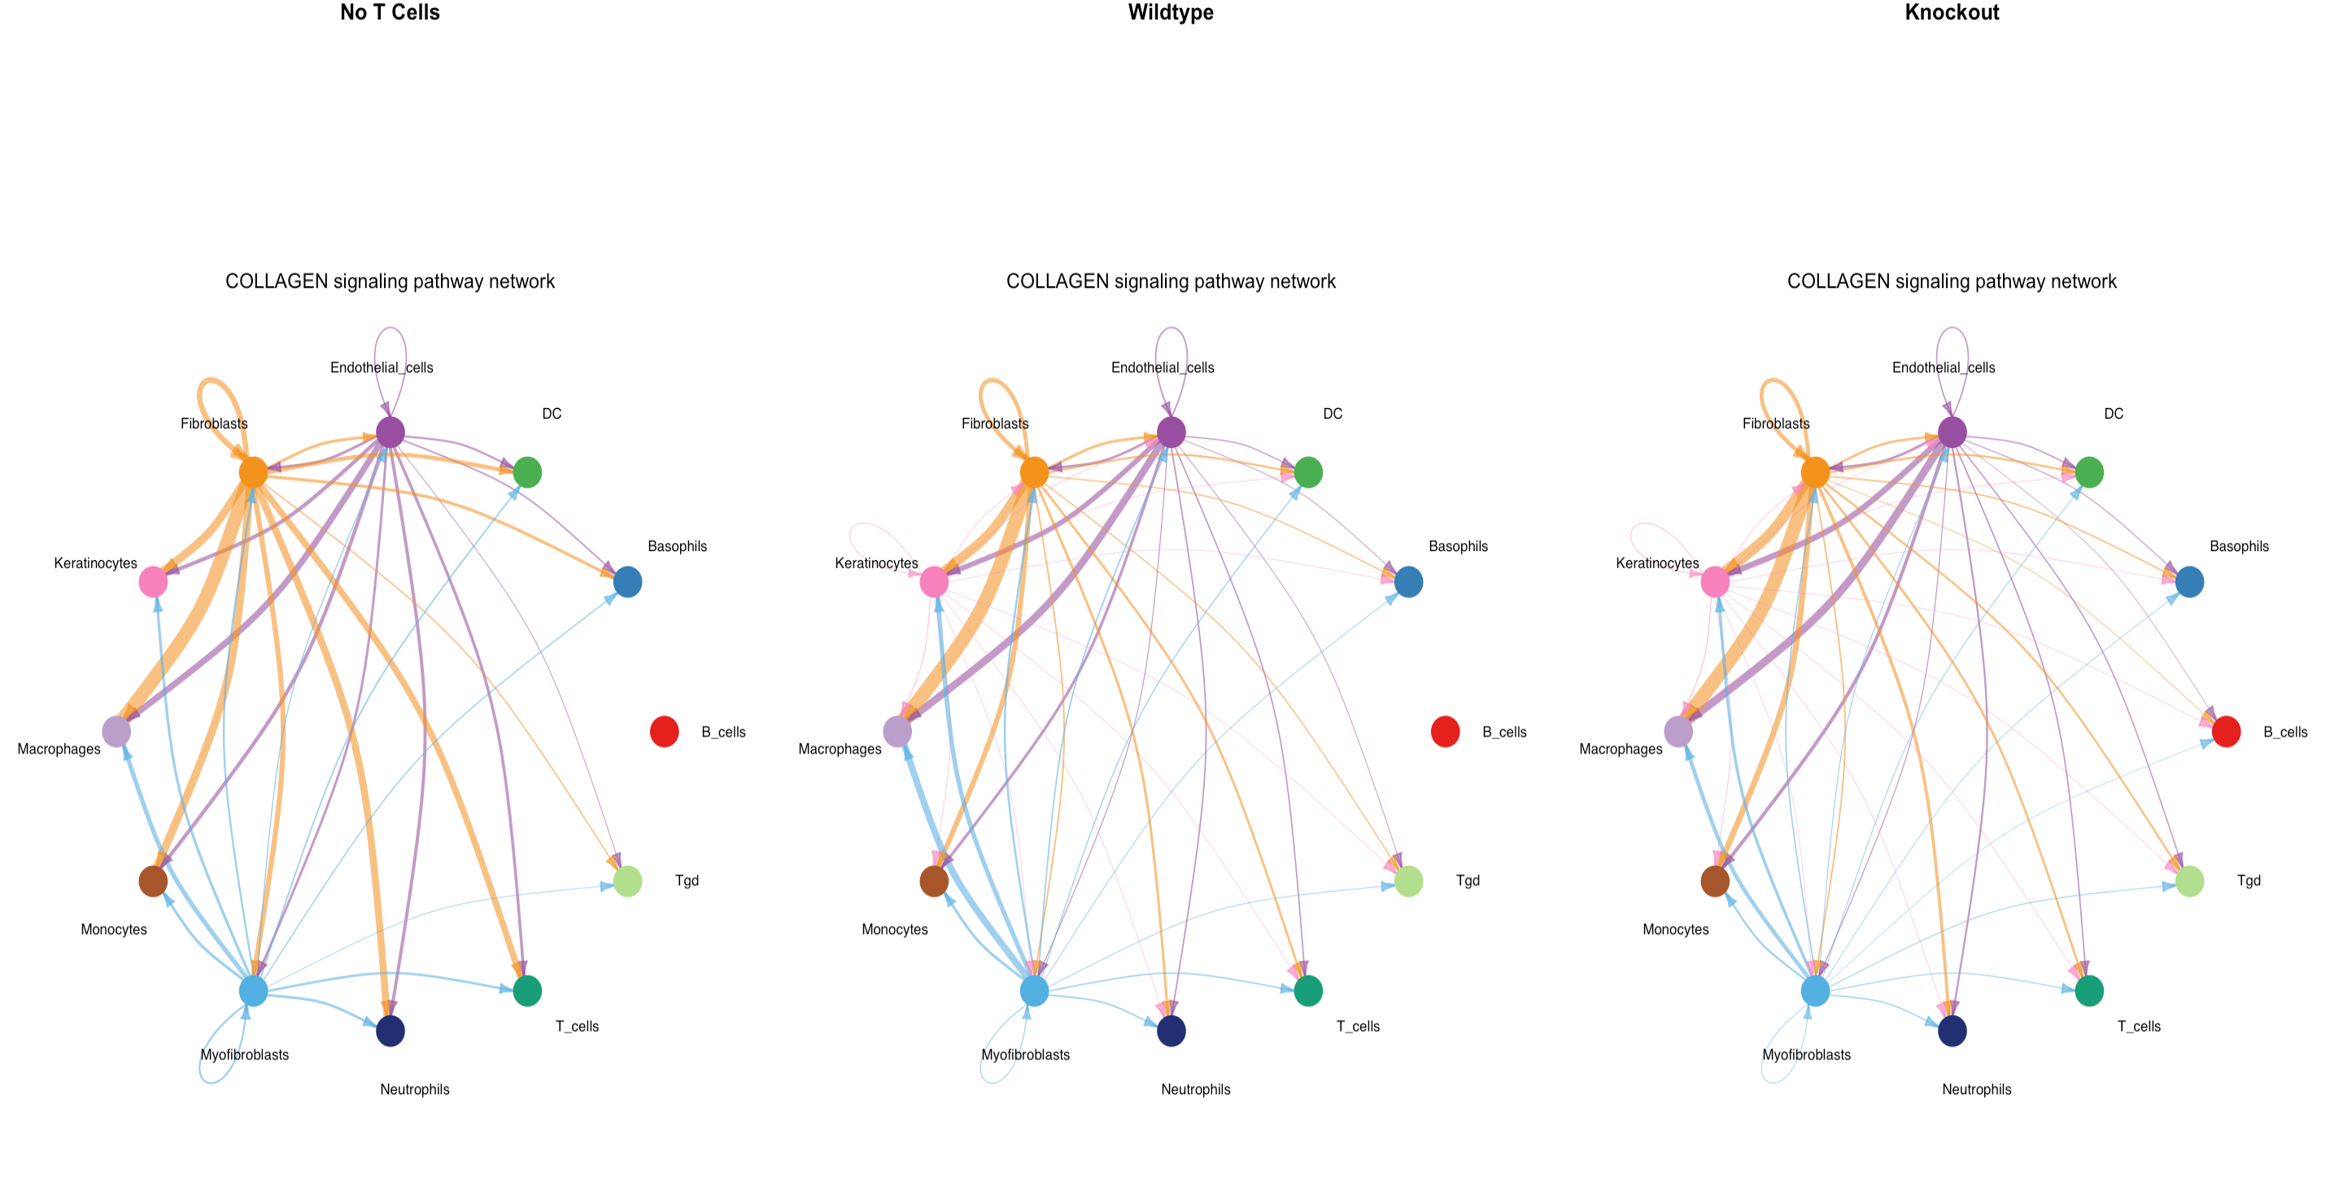
Collagen Pathway - Cell-Cell interactions
↑ Sig. from Keratinocytes
↑ Sig. from Myofibroblasts
↑ Sig. to Keratinocytes
↑ Sig. to B cells

Slide 13
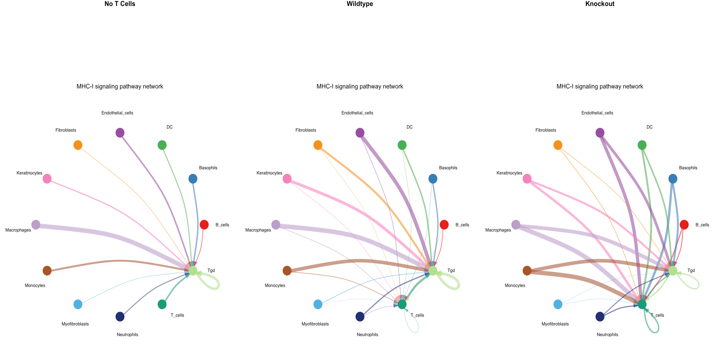
MHC-1 Pathway - Cell-Cell interactions
↓ Sig. to Tgd
↑ Sig. to T cells
↑ All cells to T cells
↑ B cells to T cells
MHC-I pathway only based on Tgd as target
↑ Sig. to Tgd (Immune reaction)
↑ Sig. to T cells
↑ B cells to T cells
→ KO upregulating alternative pathways to maintain CD4+ interactions with HDAC2 deletion.
Notes:
There is a reduction in Tgd cells as target in the MHC-I pathway. However, otherwise there seems to be an increase in cell signalling. Knockout mice often activate compensatory mechanisms to counteract the loss or alteration of a particular gene or protein. It's possible that the knockout mouse is upregulating alternative signaling pathways to maintain or modulate interactions with CD4+ T-cells in the absence of HDAC2. B-cells seem to start communicating with T-cells.

Slide 14
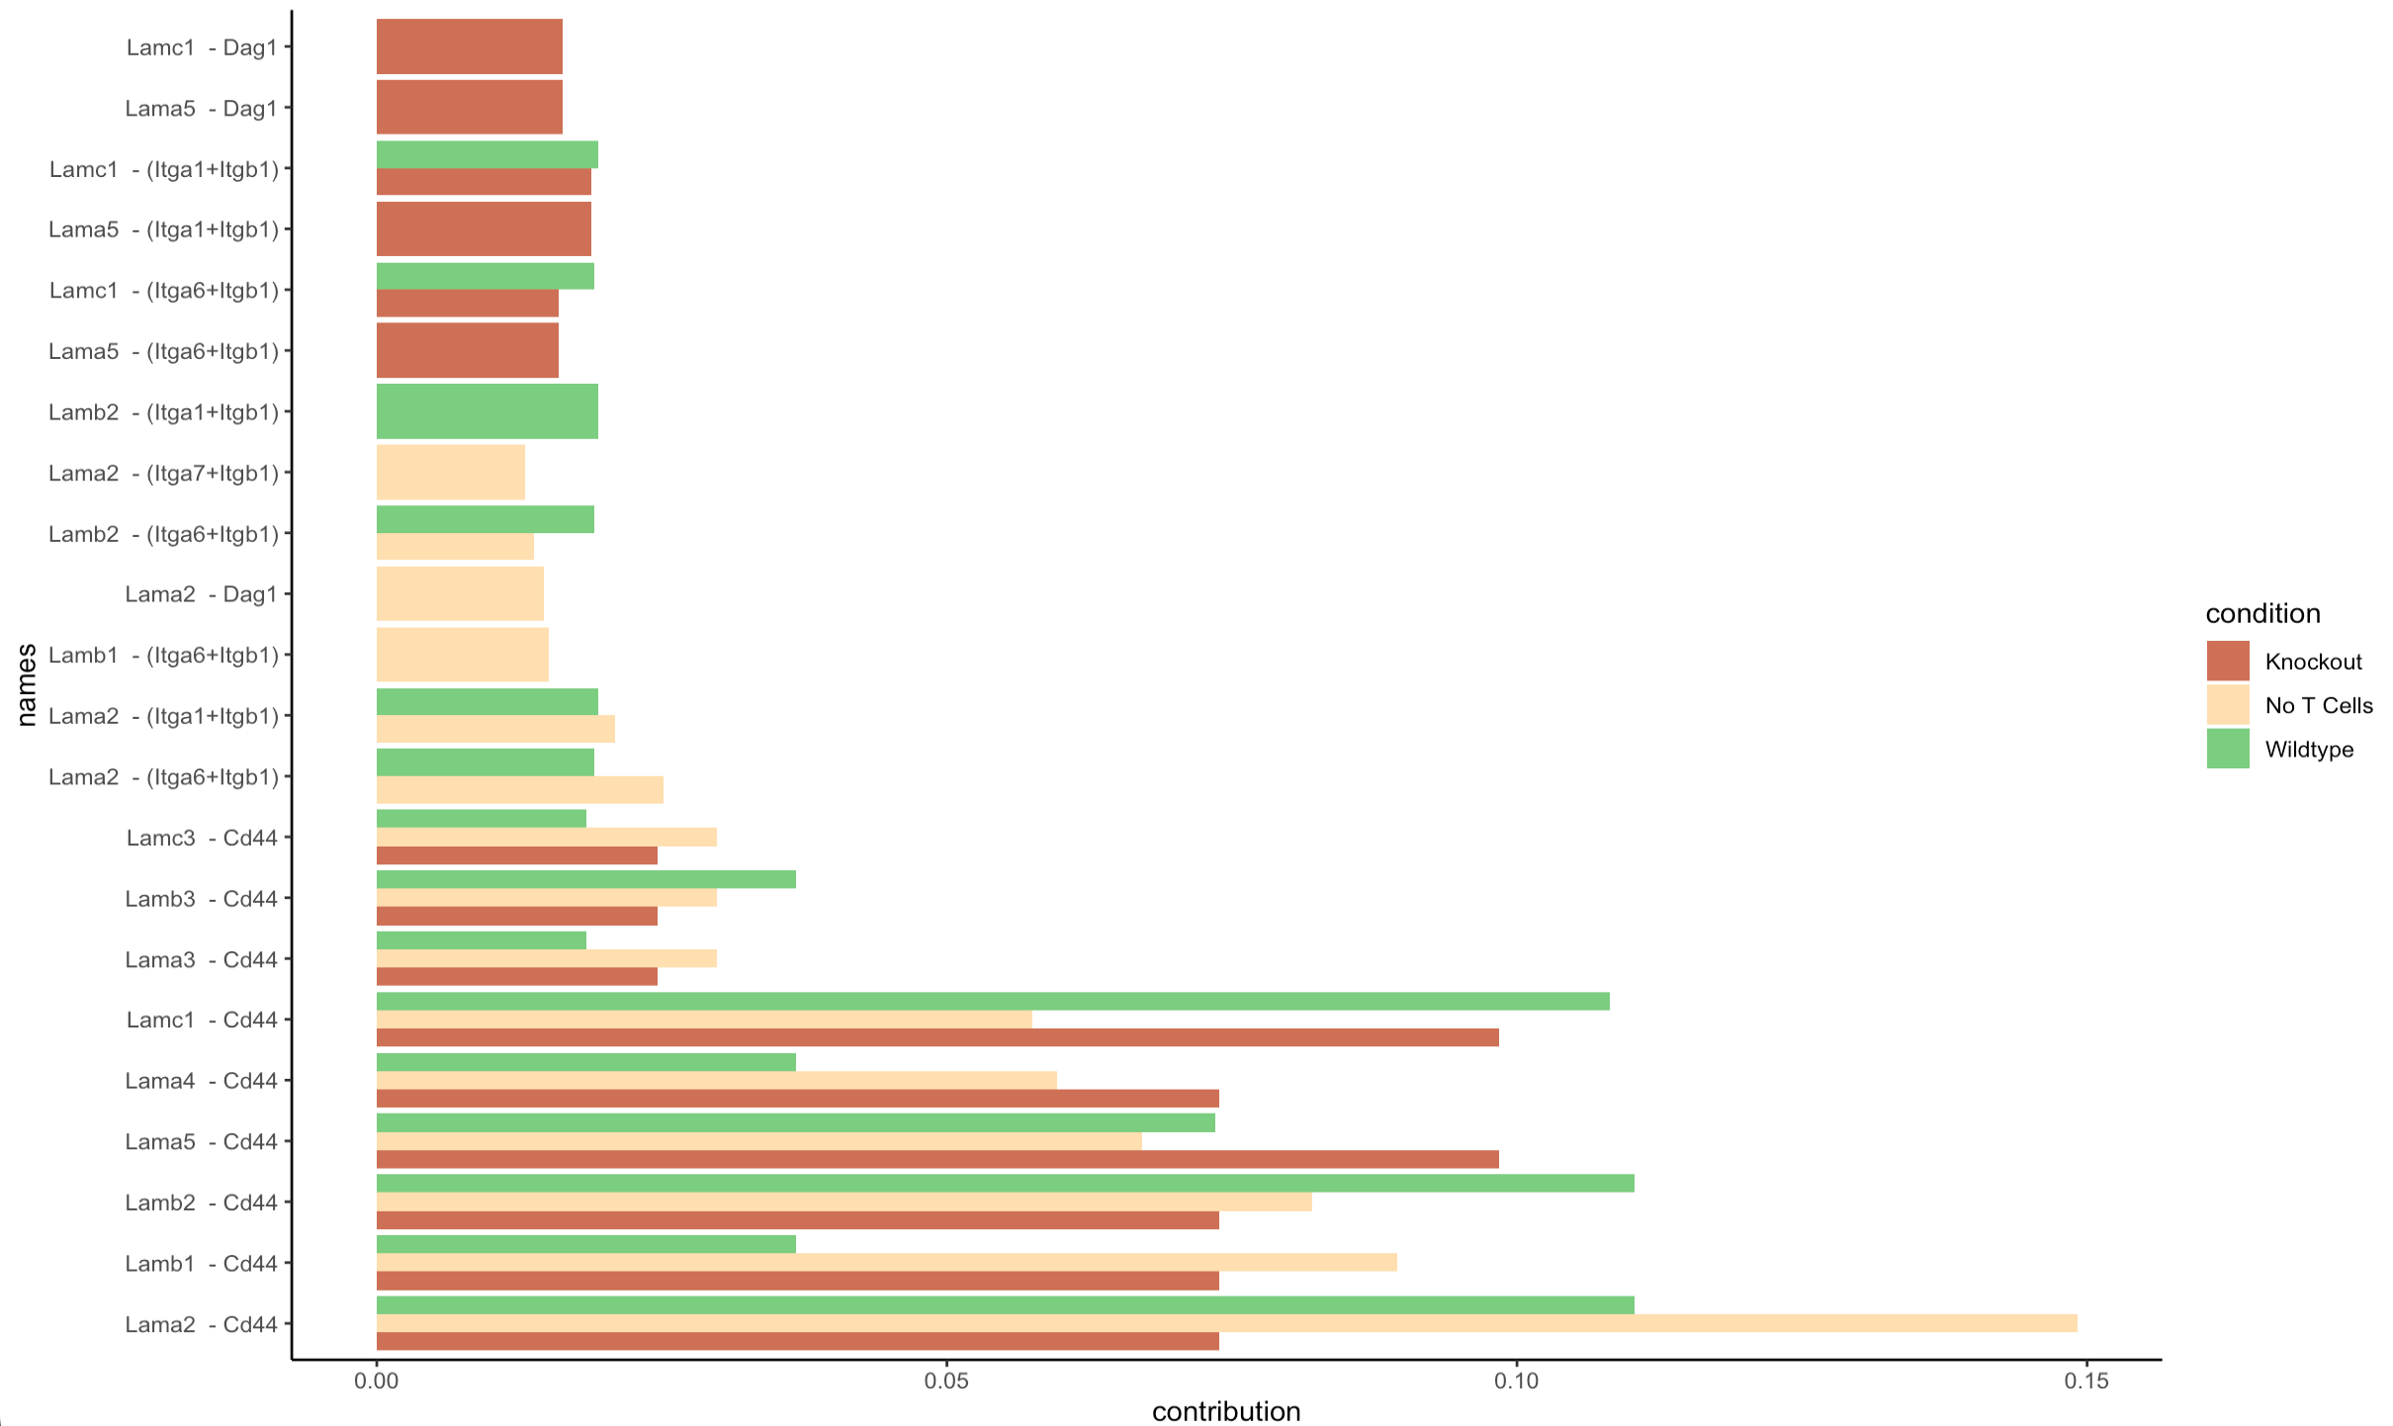
Receptor-ligand pair contribution: Laminin pathway

Slide 15
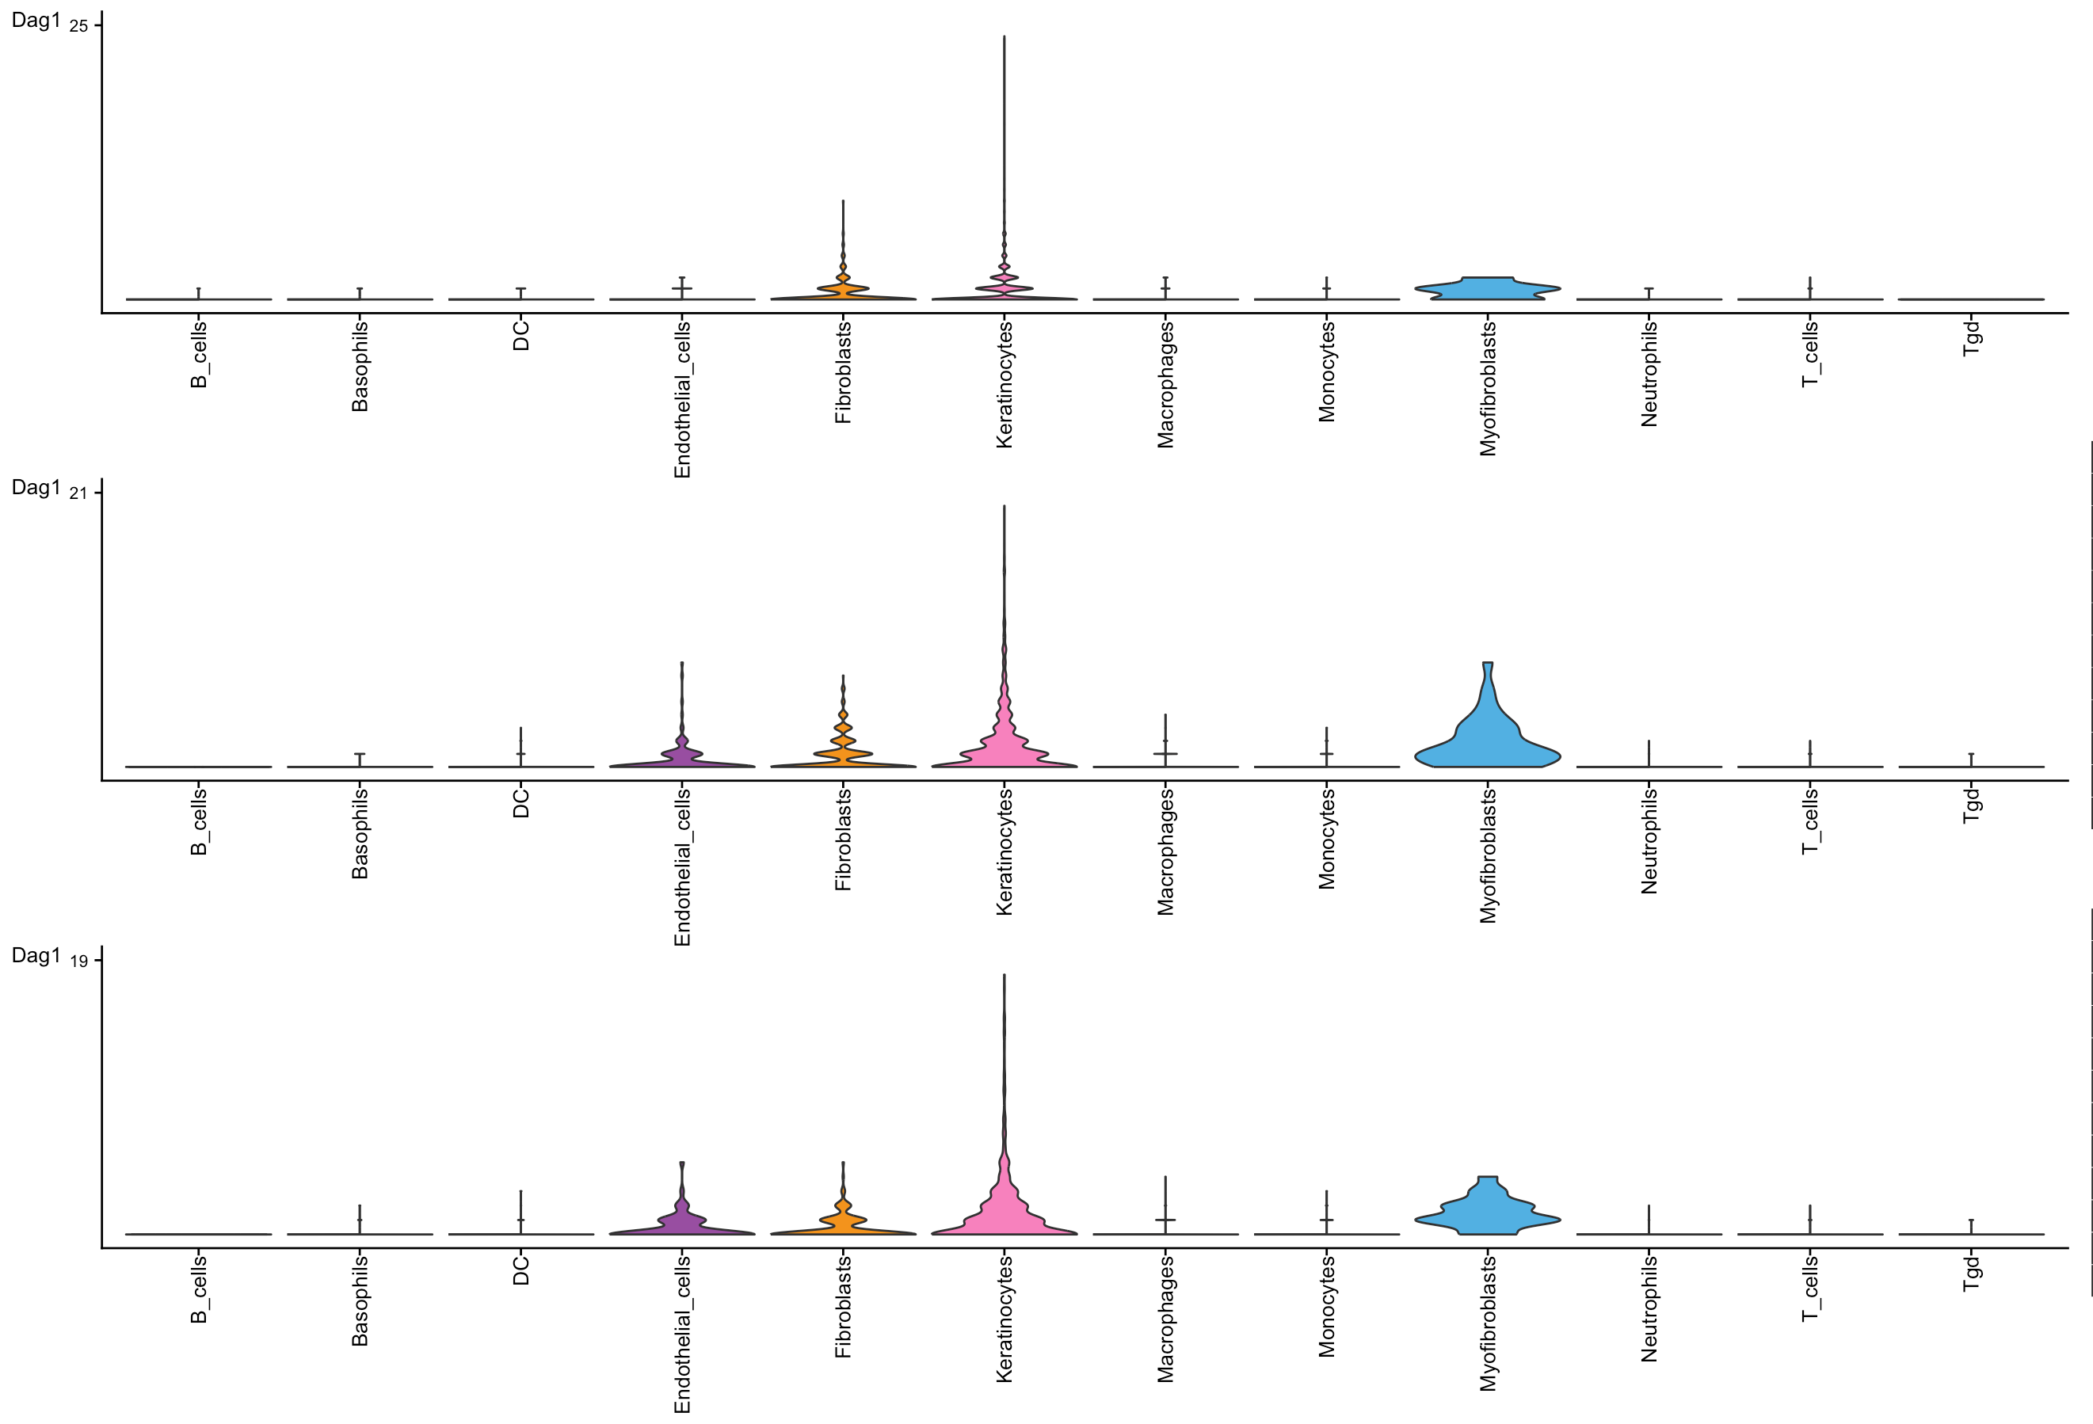
Dag1 receptor expression in Laminin pathway
Involved in connecting cells to extracellular matrix
No T cell
Wildtype
Knockout

Slide 16
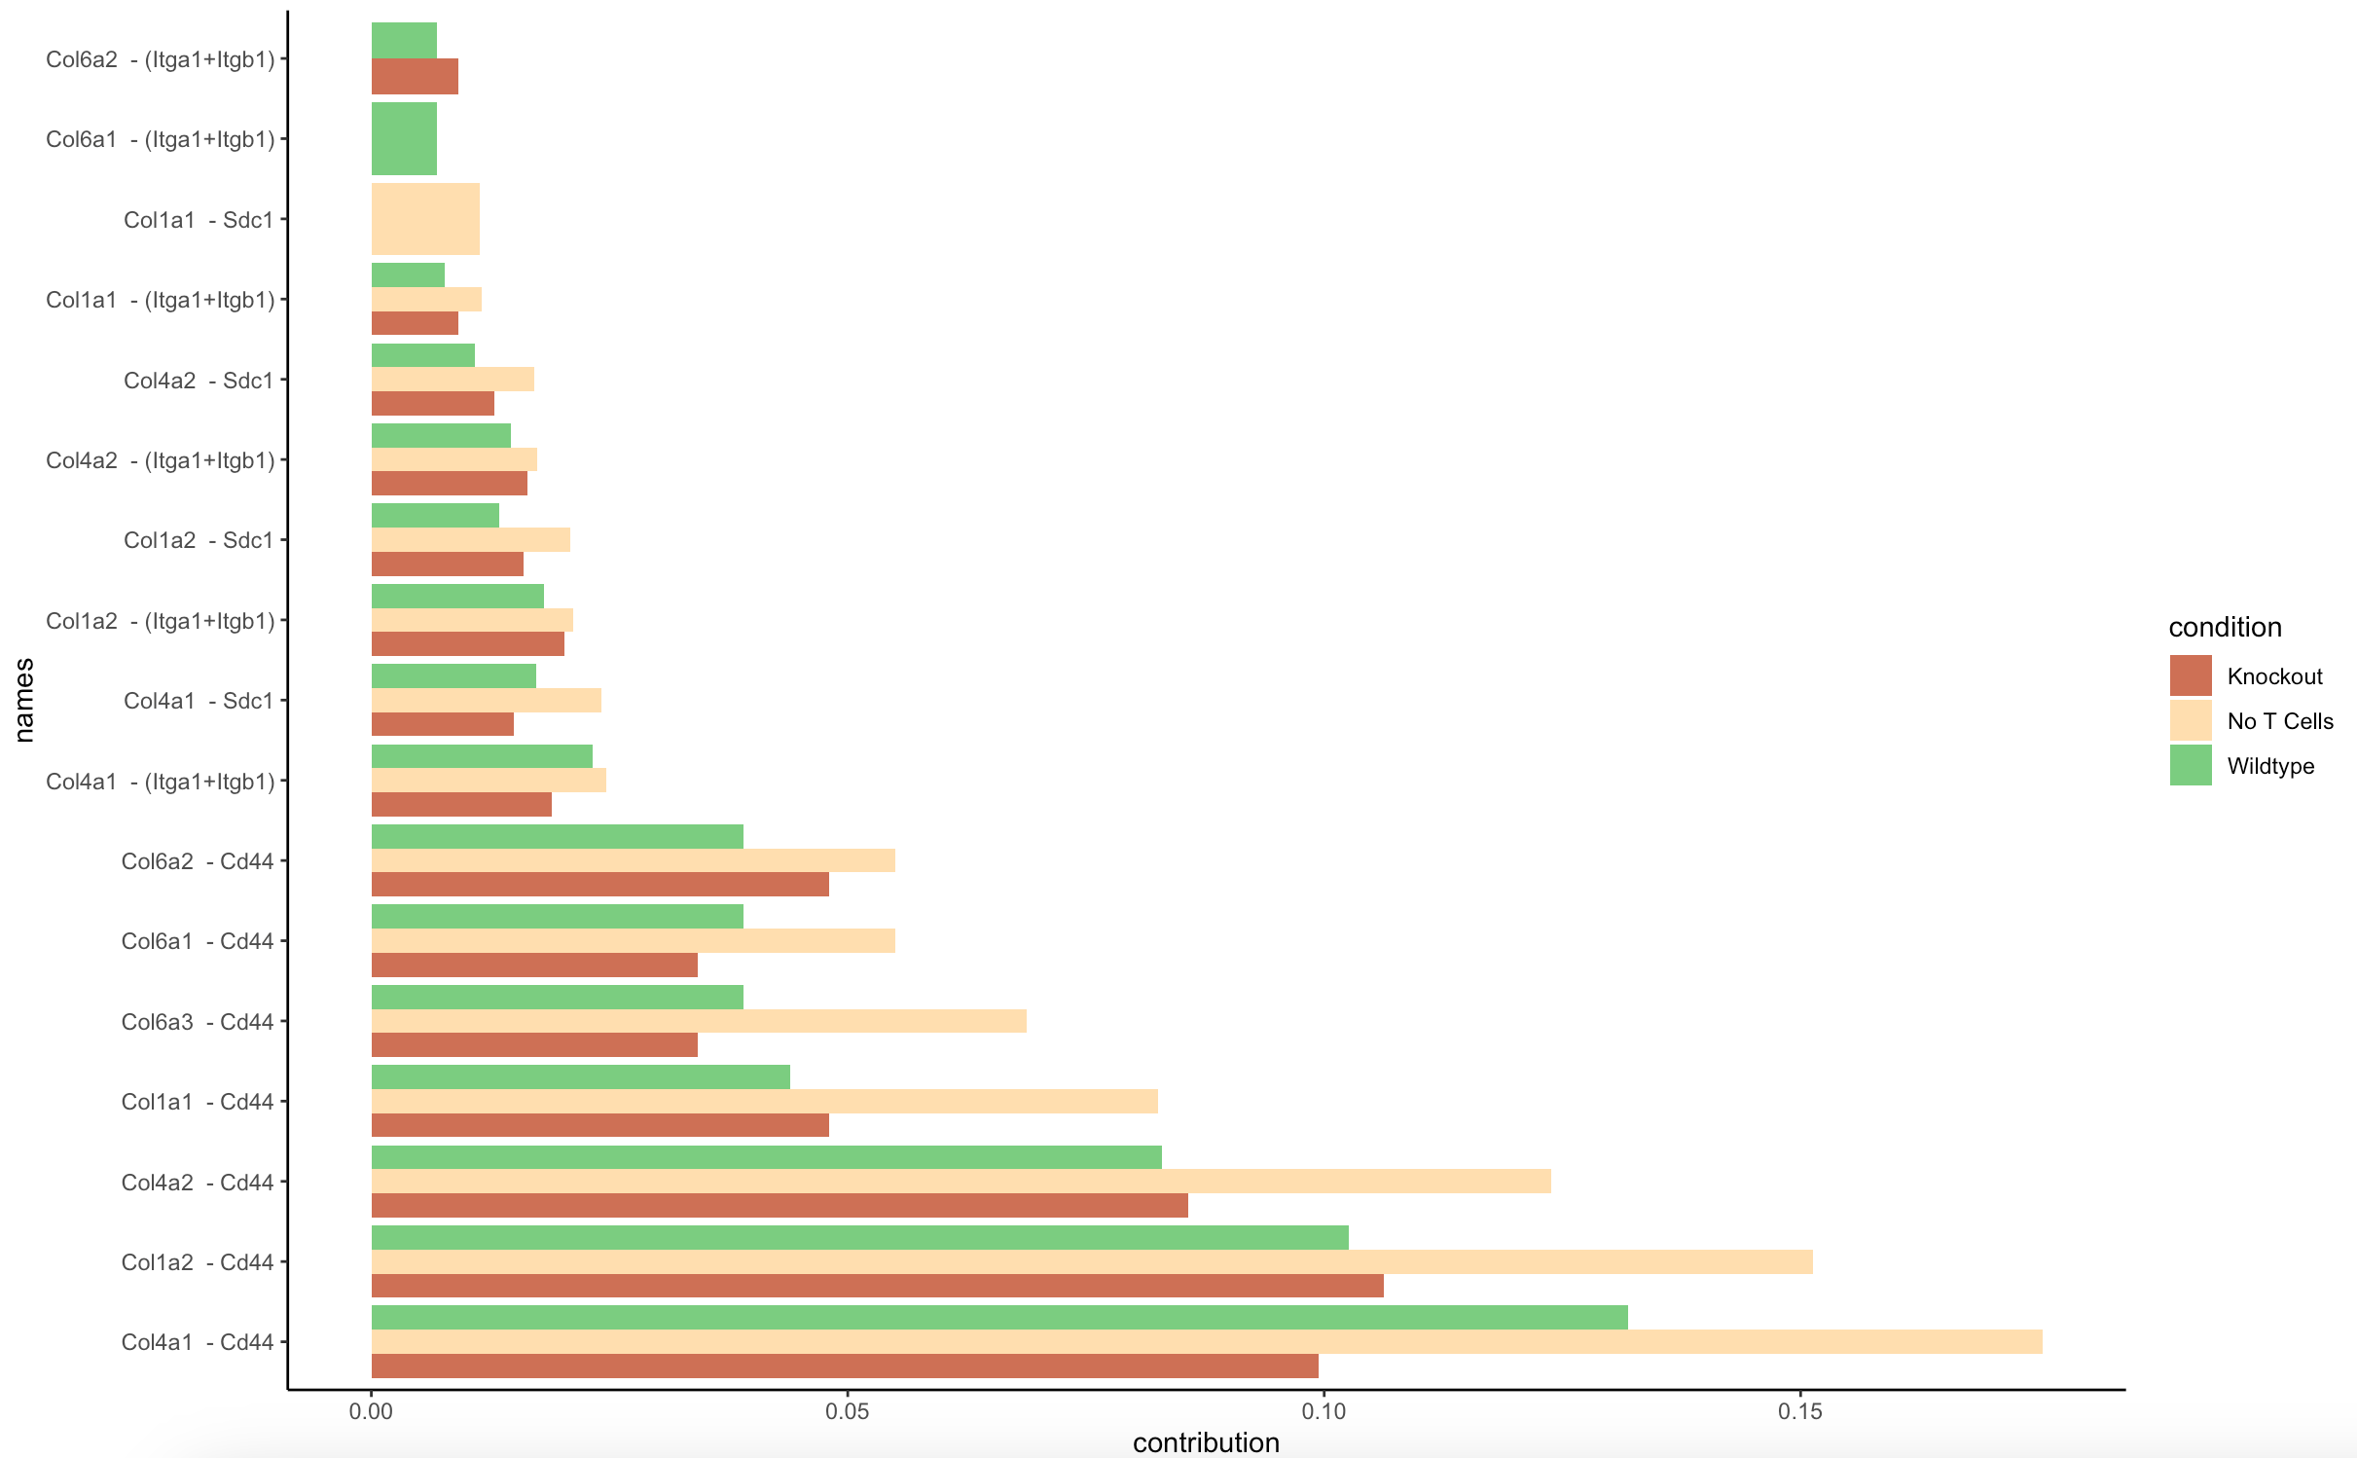
Receptor- ligand pair contribution: Collagen

Slide 17
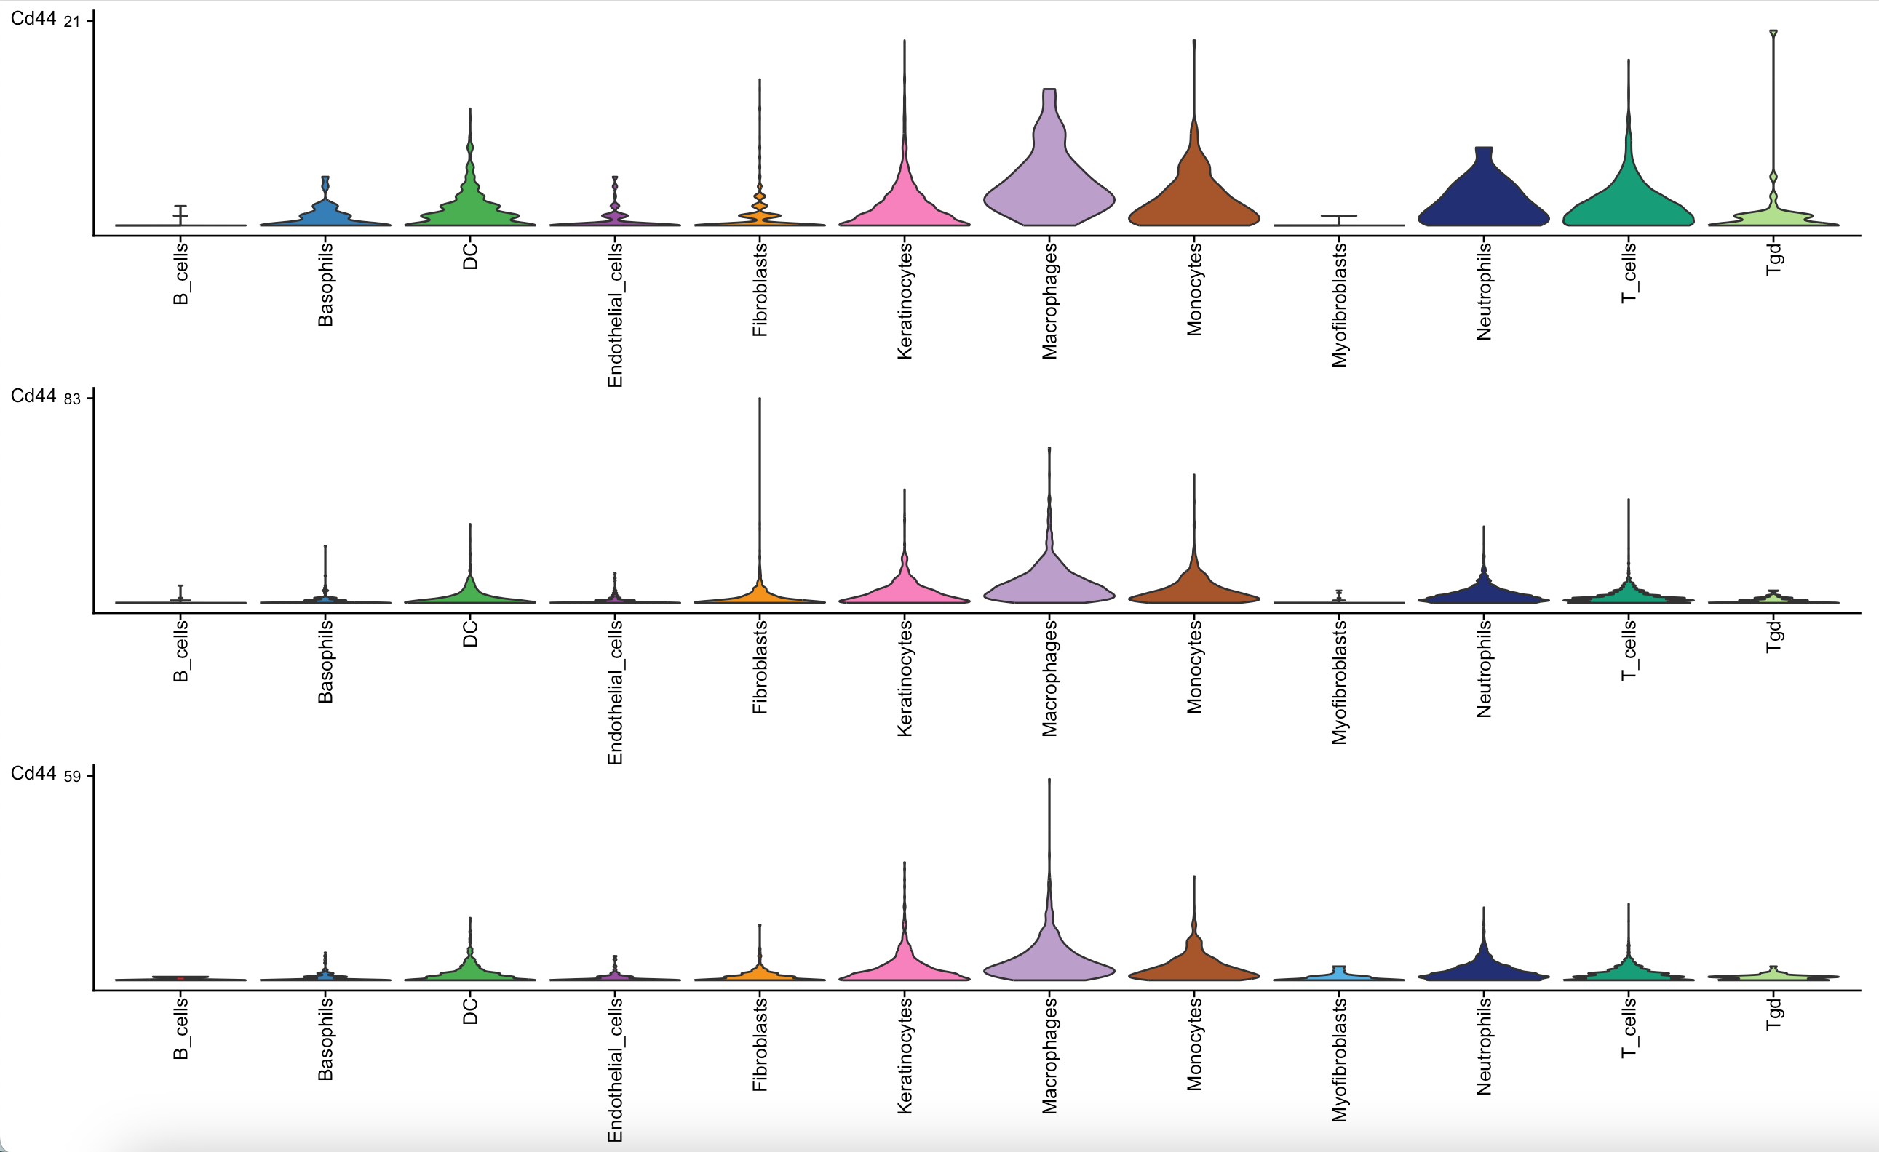
Cd44 receptor expression in Laminin + Collagen pathways
Involved in guiding immune cells to sites of inflammation
No T cell
Wildtype
Knockout

Slide 18
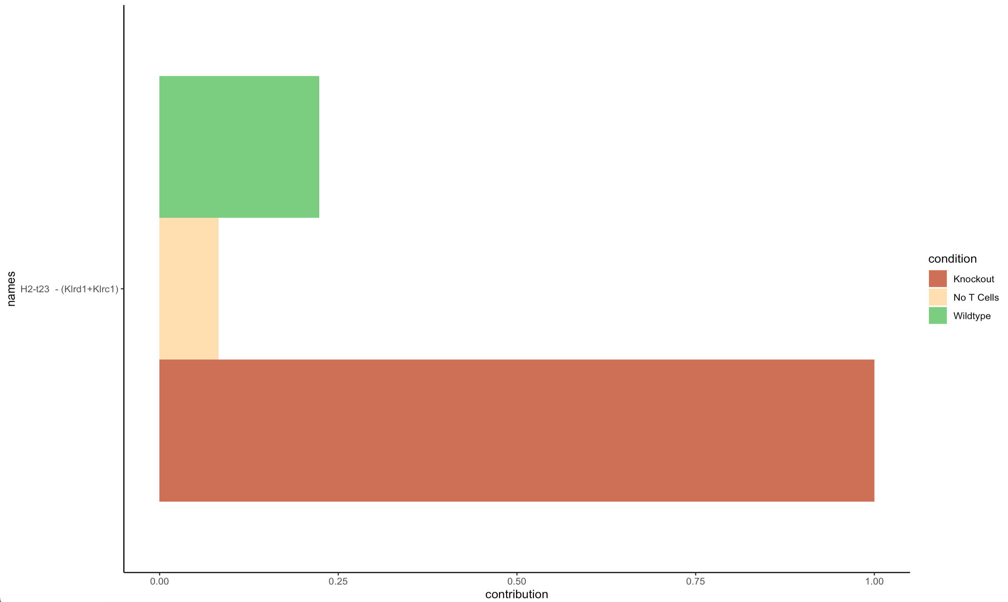
Ligand- receptor pair contribution: MHC-I
→ 100% MHC-I signalling in KO comes from H2-t23 ligand pairing with Kldr1 + Klrc1 receptor.
Notes:
Only contribution that contributes to MHC-1 pathway in Knockout cells in H2-t23 – (Klrd1 + Klrc1)

Slide 19
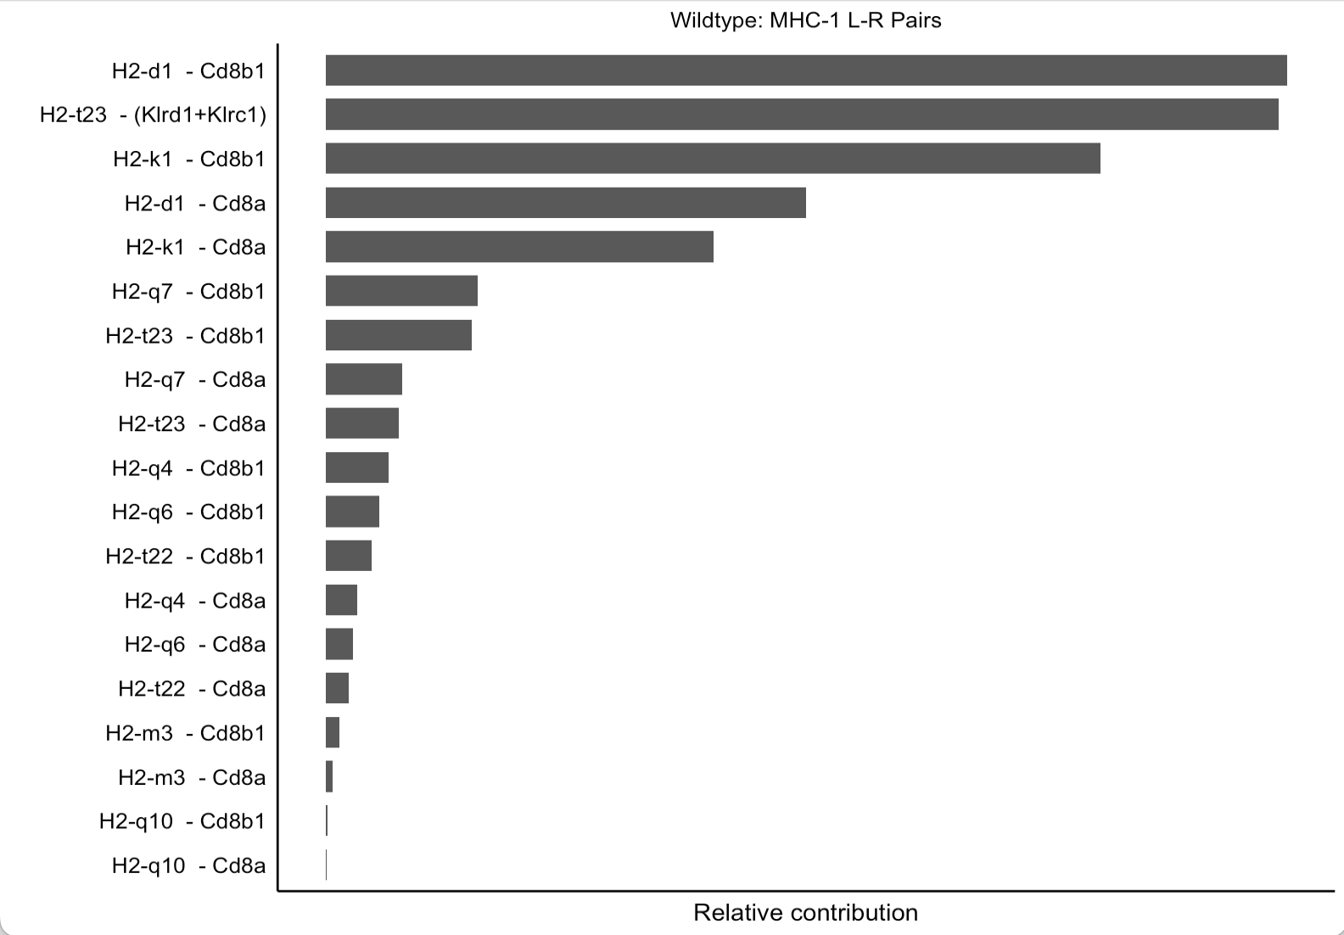
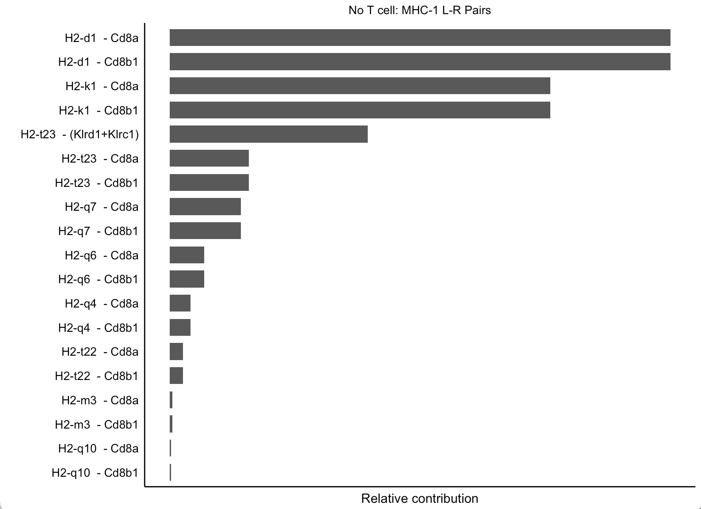
Ligand- receptor pair contribution: MHC-I in noT and wt
→ HDAC2 KO may disable Cd8a + Cd8b1 receptor function.

Slide 20
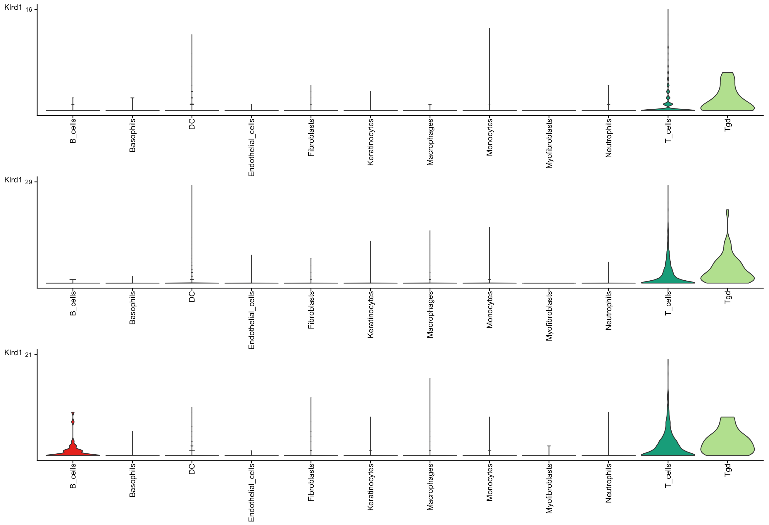
Klrd1 expression in MHC-I Pathway
Encodes protein on NK cell surface
No T cell
Wildtype
Knockout

Slide 21
Take Home
Laminin + Collagen Pathways
↑ Cell-cell interactions in KO, highest in Wt mice → Immune reaction.
↑ Laminin + Collagen pathway signalling in KO + Wt mice.
↑ Dag1 expression in Wt and KO mice in cells related to EC matrix.
↑ Cd44 receptor signalling in Wt and KO mice.
MHC-I Pathway
↓ MHC-I signalling to Tgd cells in KO mice.
↑ H2-t23 – (Klrd1 + Klrc1) receptor – ligand signalling in MHC-I pathway of KO mice (100% contribution).
MHC-I pathway severely effected by HDAC2 KO. Compensated with signalling to NK cells + B cells.
↑ Klrd1 expression in KO B cells.

Slide 22
Questions + next steps
Why are immune cells such as DCs, Neutrophils, Basophils not changed significantly? Does No T cell mouse have innate immune response?
What effects does the HDAC2 have on regulating severity of immune response and the formation of memory T cells?
Evaluate changes in cytokine signalling that could be influencing B cell signalling in the KO.
How would cell signalling change in cells exposed to an antigen other than OVA?
Knockout HDAC1 or other vital transcription factor.
Analyze other ligand-receptor interactions.

Slide 23
Thank you for listening! ☺

